Slide 1

Salary Prediction Using Ensemble Learning with IBM Watson
Explore how AI and ensemble methods, powered by IBM Watson, are revolutionising salary prediction for HR and recruitment in India's dynamic job market.

Slide 2



Introduction to Salary Prediction
Our primary goal is to accurately estimate salaries based on job features and experience. This approach empowers companies to establish fair compensation structures and enables candidates to negotiate effectively.
Goal Setting
Fair Compensation
Data-Driven Insights
Estimate salaries accurately based on job features and experience.
Helps companies set fair pay scales and candidates negotiate better offers.
Utilises historical job posting data with detailed salary labels.

Slide 3
What is Ensemble Learning?
Ensemble learning combines multiple machine learning models to achieve superior predictive performance compared to a single model.
By integrating diverse predictions, it significantly reduces the risks of overfitting and variance, ensuring more robust and reliable outcomes.

Slide 4

IBM Watson for Machine Learning
IBM Watson offers a comprehensive AI platform equipped with advanced tools for every stage of the machine learning pipeline.
End-to-End Platform: Tools for data preparation, model building, and seamless deployment.
Algorithm Support: Natively supports robust ensemble algorithms such as Random Forest and XGBoost.
Automated Optimisation: Features automated hyperparameter tuning and extensive model evaluation capabilities.

Slide 5





Dataset and Features Overview
Our analysis leverages a comprehensive dataset of over one million job postings, enriched with detailed salary information.
Job Type
Education
Industry Sector
Categorises roles (e.g., software engineer, marketing specialist).
Includes highest degree obtained and major.
Specific industry (e.g., IT, finance, healthcare).
Experience
Location
Years of relevant professional experience.
Geographic region of the job posting.

Slide 6
Data Preprocessing Steps
Rigorous data preprocessing is crucial for building accurate and reliable salary prediction models. These steps ensure data quality.
Split Data
Remove Outliers
Divided into distinct training and test sets for robust model validation.
Handle Categorical Variables
Identified and eliminated extreme salary entries to prevent model distortion.
Transformed with one-hot encoding for machine learning compatibility.

Slide 7
Ensemble Models Used
We employed sophisticated ensemble techniques to enhance predictive accuracy, alongside a baseline model for comparative analysis.
Random Forest Regression
Gradient Boosting (XGBoost)
Baseline Linear Regression
Combines predictions from multiple decision trees to improve stability and accuracy.
Sequentially builds and refines weak learners to achieve highly accurate predictions.
Used as a benchmark to demonstrate the superior performance of ensemble methods.

Slide 8
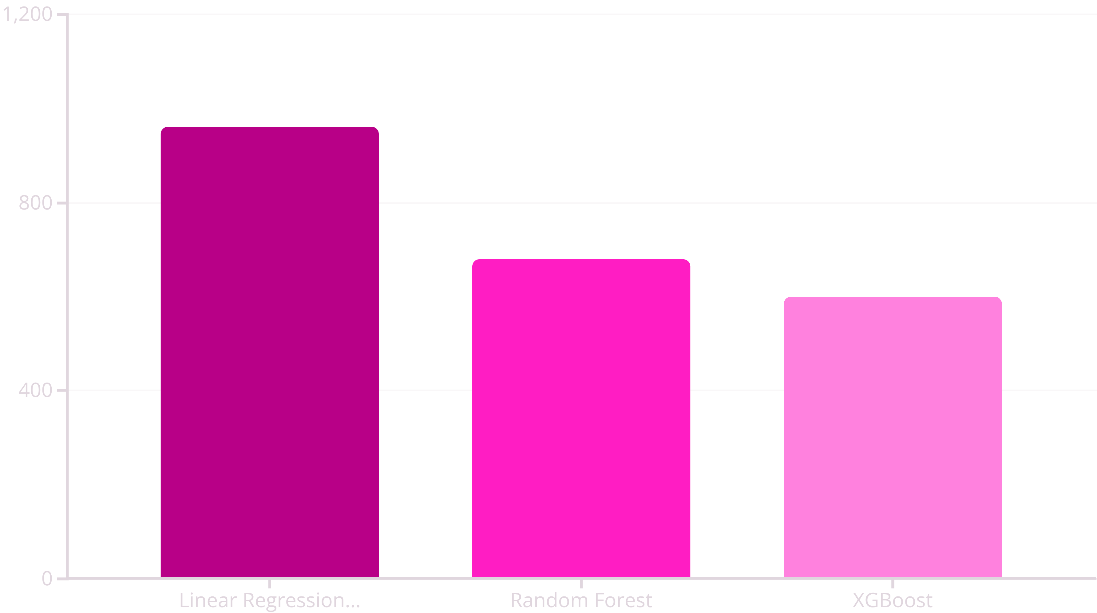
Model Training and Evaluation
Our models underwent rigorous training and evaluation to ensure optimal performance, focusing on key accuracy metrics.
Ensemble models significantly reduced the Mean Squared Error (MSE), with XGBoost achieving the best performance.

Slide 9
Deployment with IBM Watson Studio
The trained models are seamlessly integrated into IBM Watson Studio, providing a scalable and intuitive platform for salary predictions.
1
2
3
Scalable Integration
HR Dashboard
Data-Driven Decisions
Models are deployed within Watson Studio for efficient and scalable predictions.
An intuitive dashboard allows HR managers to input job features and instantly receive salary estimates.
Enables transparent and data-driven compensation strategies, enhancing fairness.

Slide 10

Conclusion and Future Directions
Ensemble learning, powered by IBM Watson, significantly enhances salary prediction accuracy, supporting fair pay and talent retention.
Enhanced Accuracy: Ensemble learning with IBM Watson provides precise salary predictions.
Strategic HR: Supports fair compensation and effective talent retention strategies.
Future Expansion: Incorporate real-time market data and employee performance metrics for even greater precision.

